Slide 1
Modeling Bubbles in Solution With ODEs
Edmond Bradly and Christopher Jacobs

Slide 2
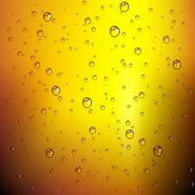
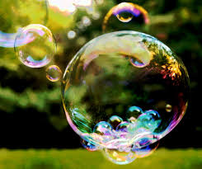
Why Bubbles?
Goal: Does a bubble rise in a solution proportionally to the surface area of the bubble? Is Archimedes principle reality?

Slide 3

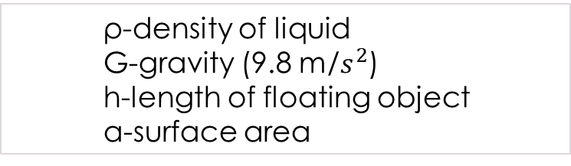

Archimedes' Principle
The force of Buoyancy is equal to the amount of liquid the bubble displaces
F_{B}
h
$F_{B}=$ρGha
$F_{B}−$the Force of Buoyancy
ρ-density of liquid
G-gravity (9.8 m/$s^{2}$)
h-length of floating object
a-surface area
G

Slide 4




Meet the System
The change in Radius:
The change in Force of Buoyancy:
The change in Height:
$$\frac{dA\left(t\right)}{dt}=ε\left(4.13π{A\left(t\right)}^{2}\right)F(t)$$
ε - Concentration of Gas in solution
$\frac{dF(t)}{dt}$= β${A\left(t\right)}^{2}$H(t)
β - Density of Liquid
${\frac{dH\left(t\right)}{dt}=αe}^{F\left(t\right)}(1−\frac{H\left(t\right)}{n}$)
$α$- Type of Gas
n-height of container

Slide 5
Assumptions:
The solution is special where all parameters equal one
As surface area increases as the height increases
The bubble forms at the bottom of the glass
The solution is not being disturbed
No Ice
Bubbles do not oscillate at top of glass

Slide 6
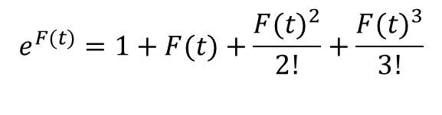
Analysis:
Linearization – unsuccessful (3 repeated eigenvalues of zero) at only eq. point (origin)
Went to graphical analysis!
DE plots
3d plots
Vector Fields
Euler's Method
Phase-portrait
Sometimes a Taylor Series expansion of $e^{F(t)}$was used
$$e^{F(t)}=1+F(t)+\frac{{F(t)}^{2}}{2!}+\frac{{F(t)}^{3}}{3!}$$

Slide 7
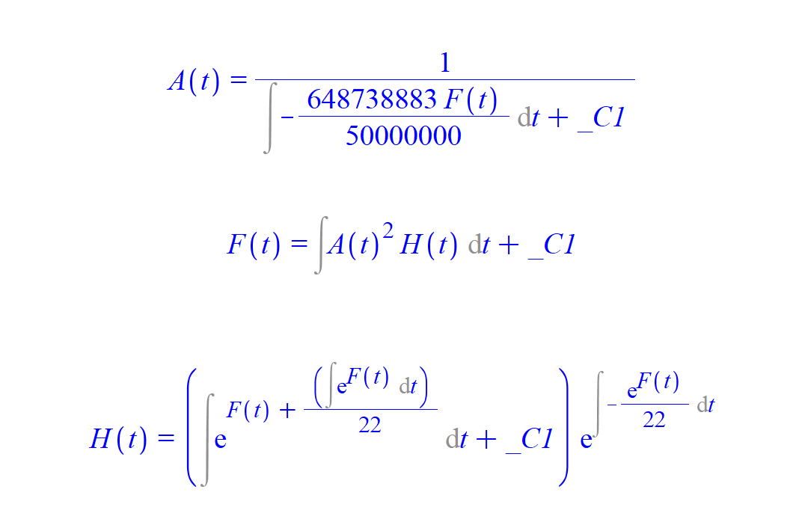
Directly solving the System:
Can’t directly solve
Try another way

Slide 8
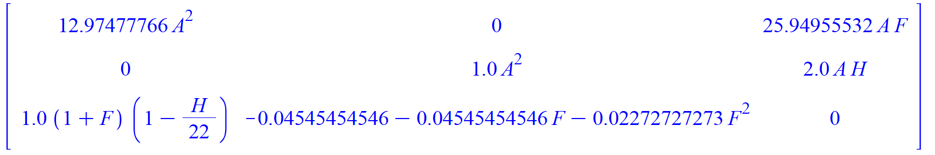
Jacobian and Linearization:
Jacobian Pre-plugging in Equilibrium values (With approximation):

Slide 9
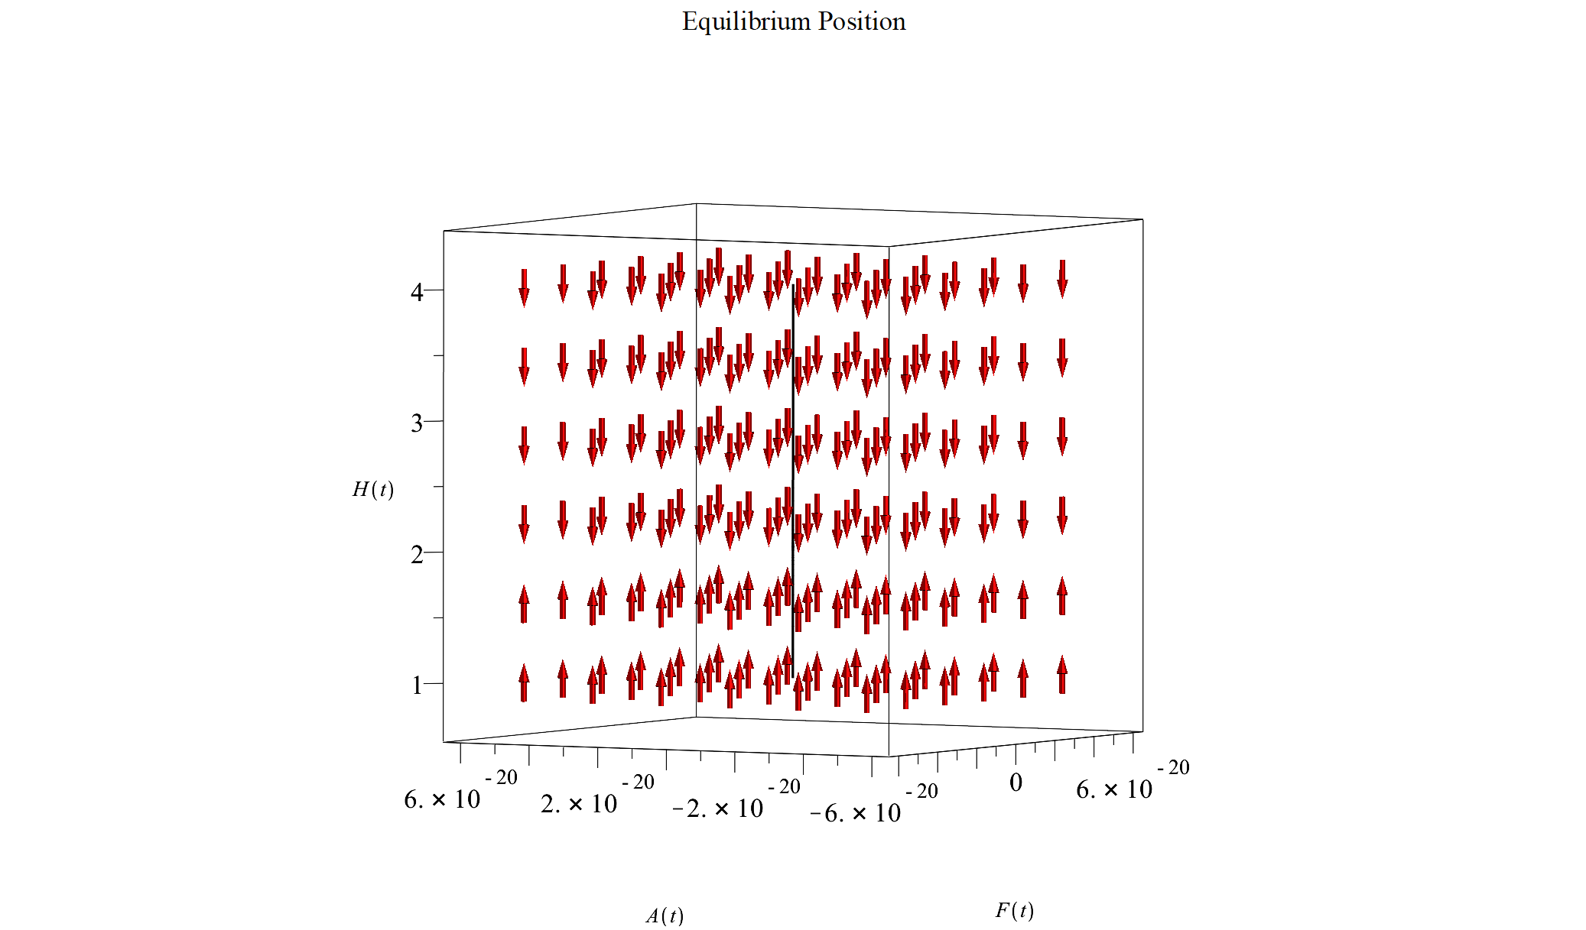
Equilibrium point:
When A(t), F(t) = 0 and H(t)= n (sink)

Slide 10
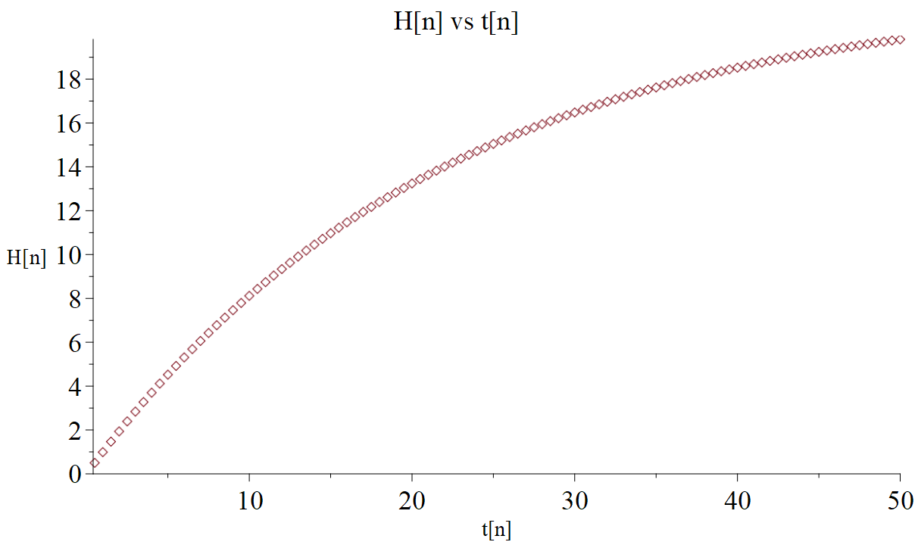
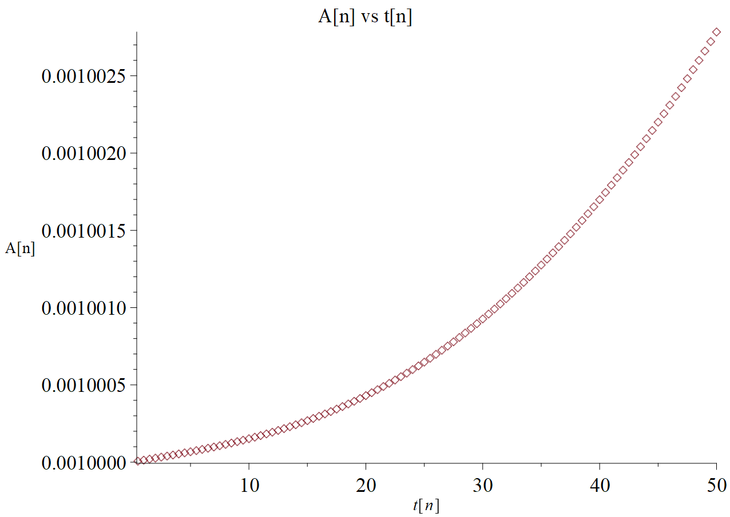
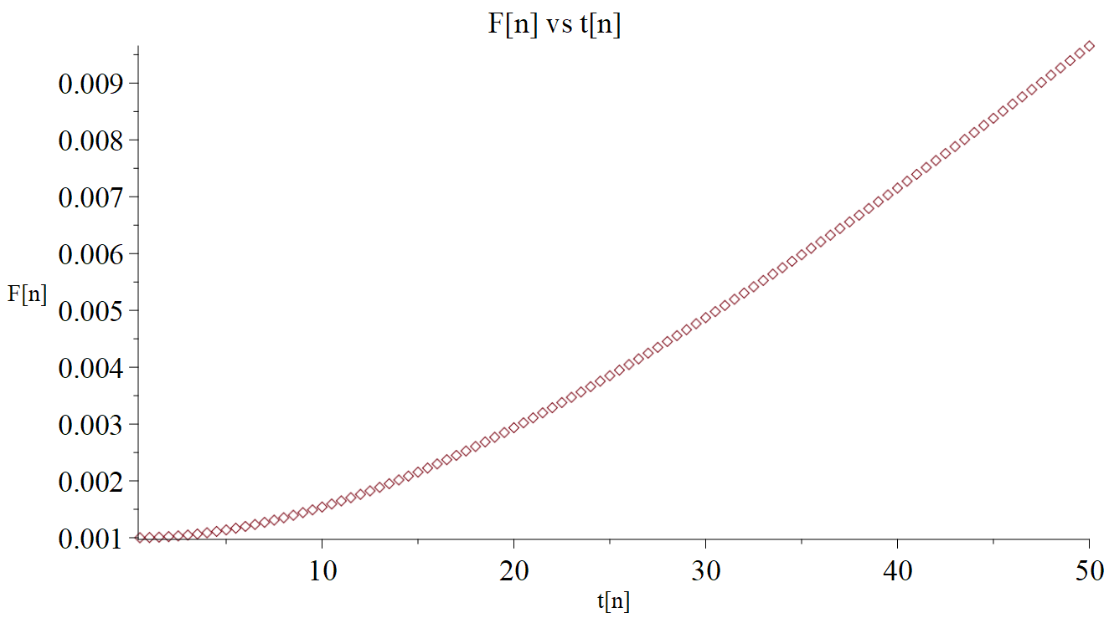
Euler’s method
Numerically solving using Euler’s method

Slide 11
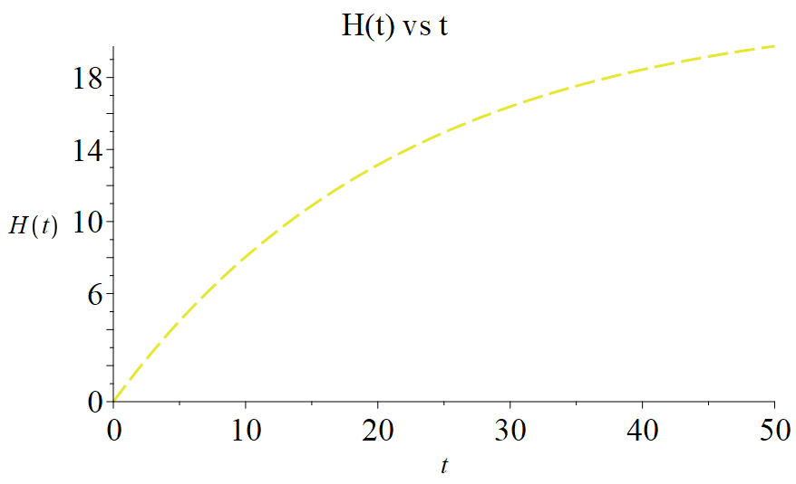
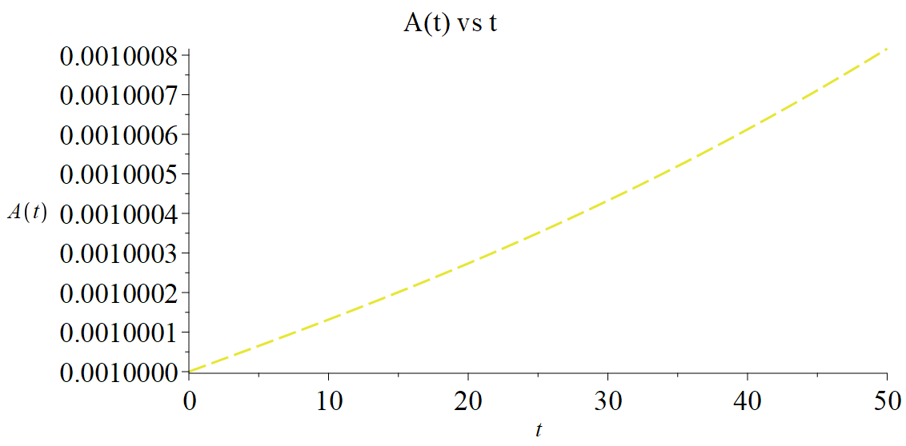
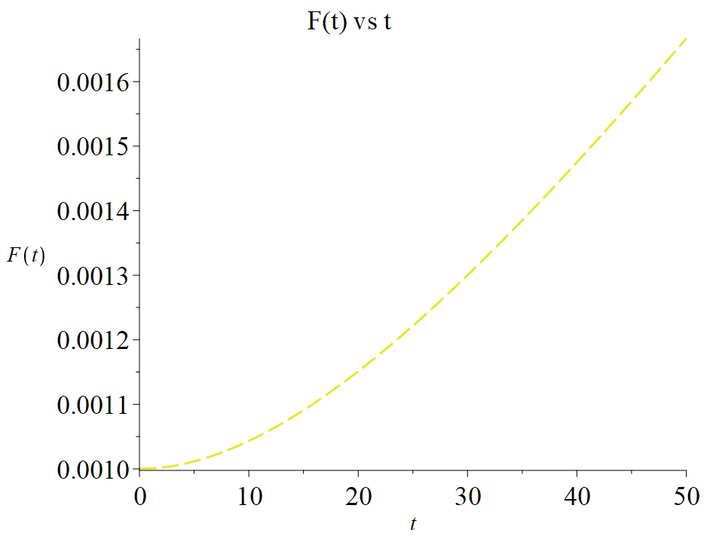
DE plots

Slide 12
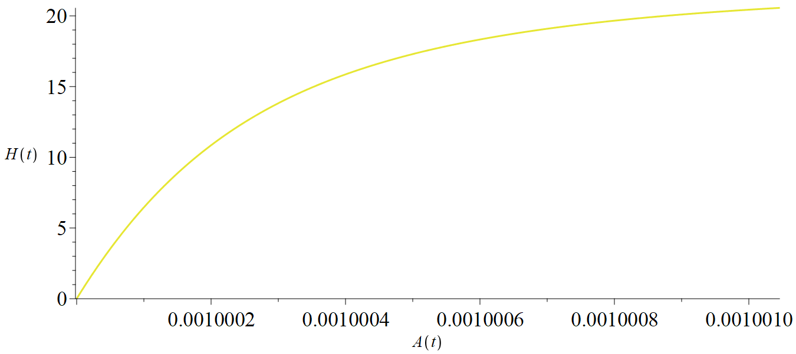
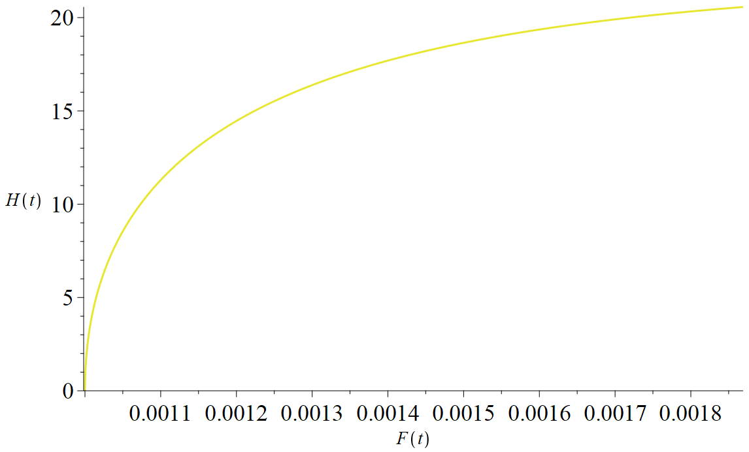
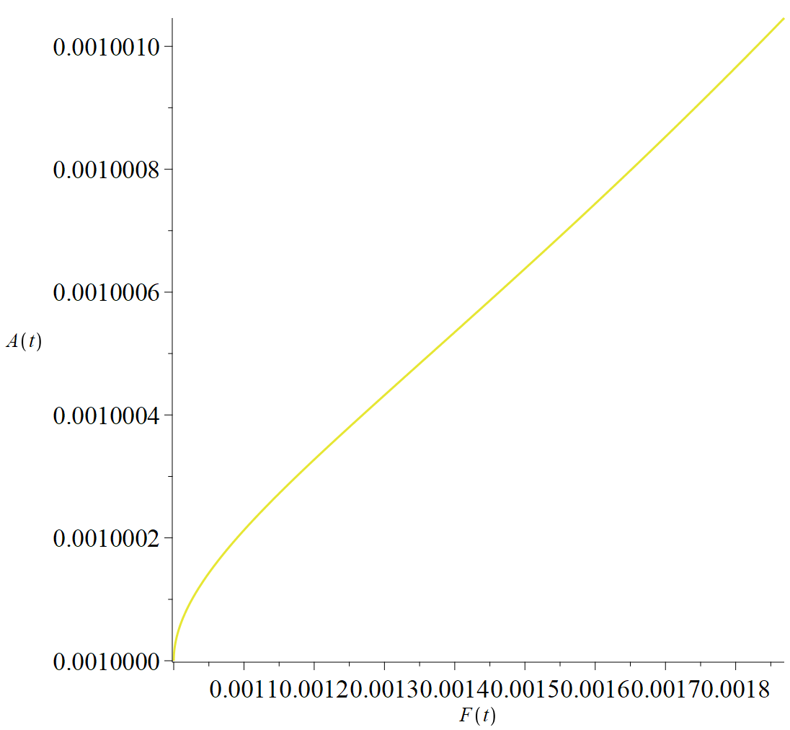
Phase Portraits

Slide 13
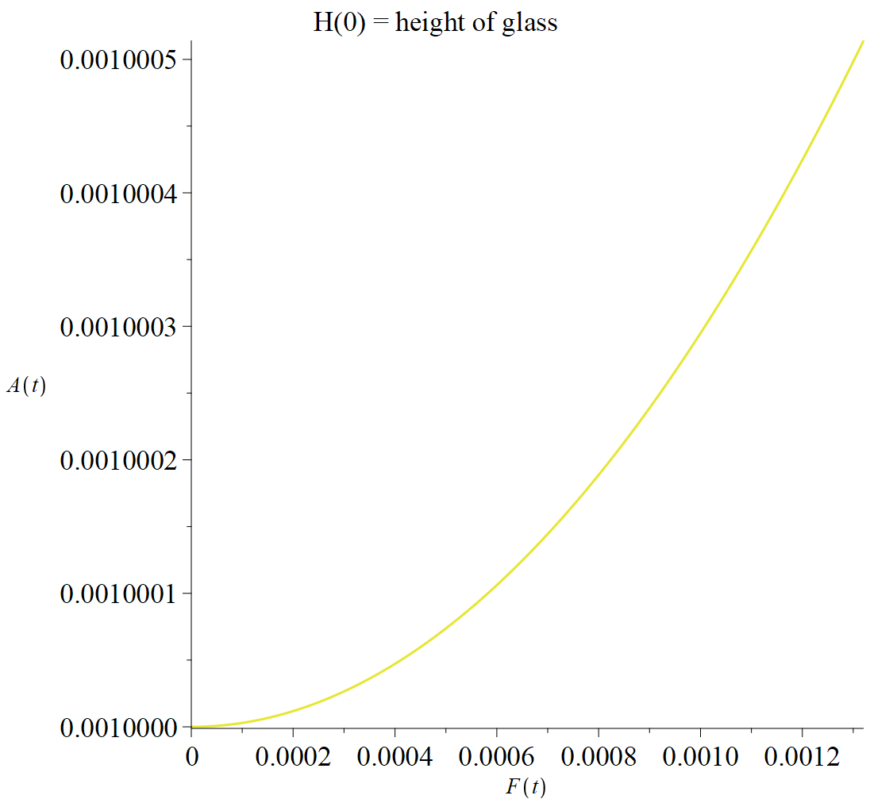
Where can improvements be made?
Oscillation of Bubble at top of glass
Bubbles do not always form at bottom of solution
What happens when you are disturbing the system
4.

Slide 14
Does this answer if Archimedes' Principle holds true?

Slide 15

Are There any Questions

